Slide 1
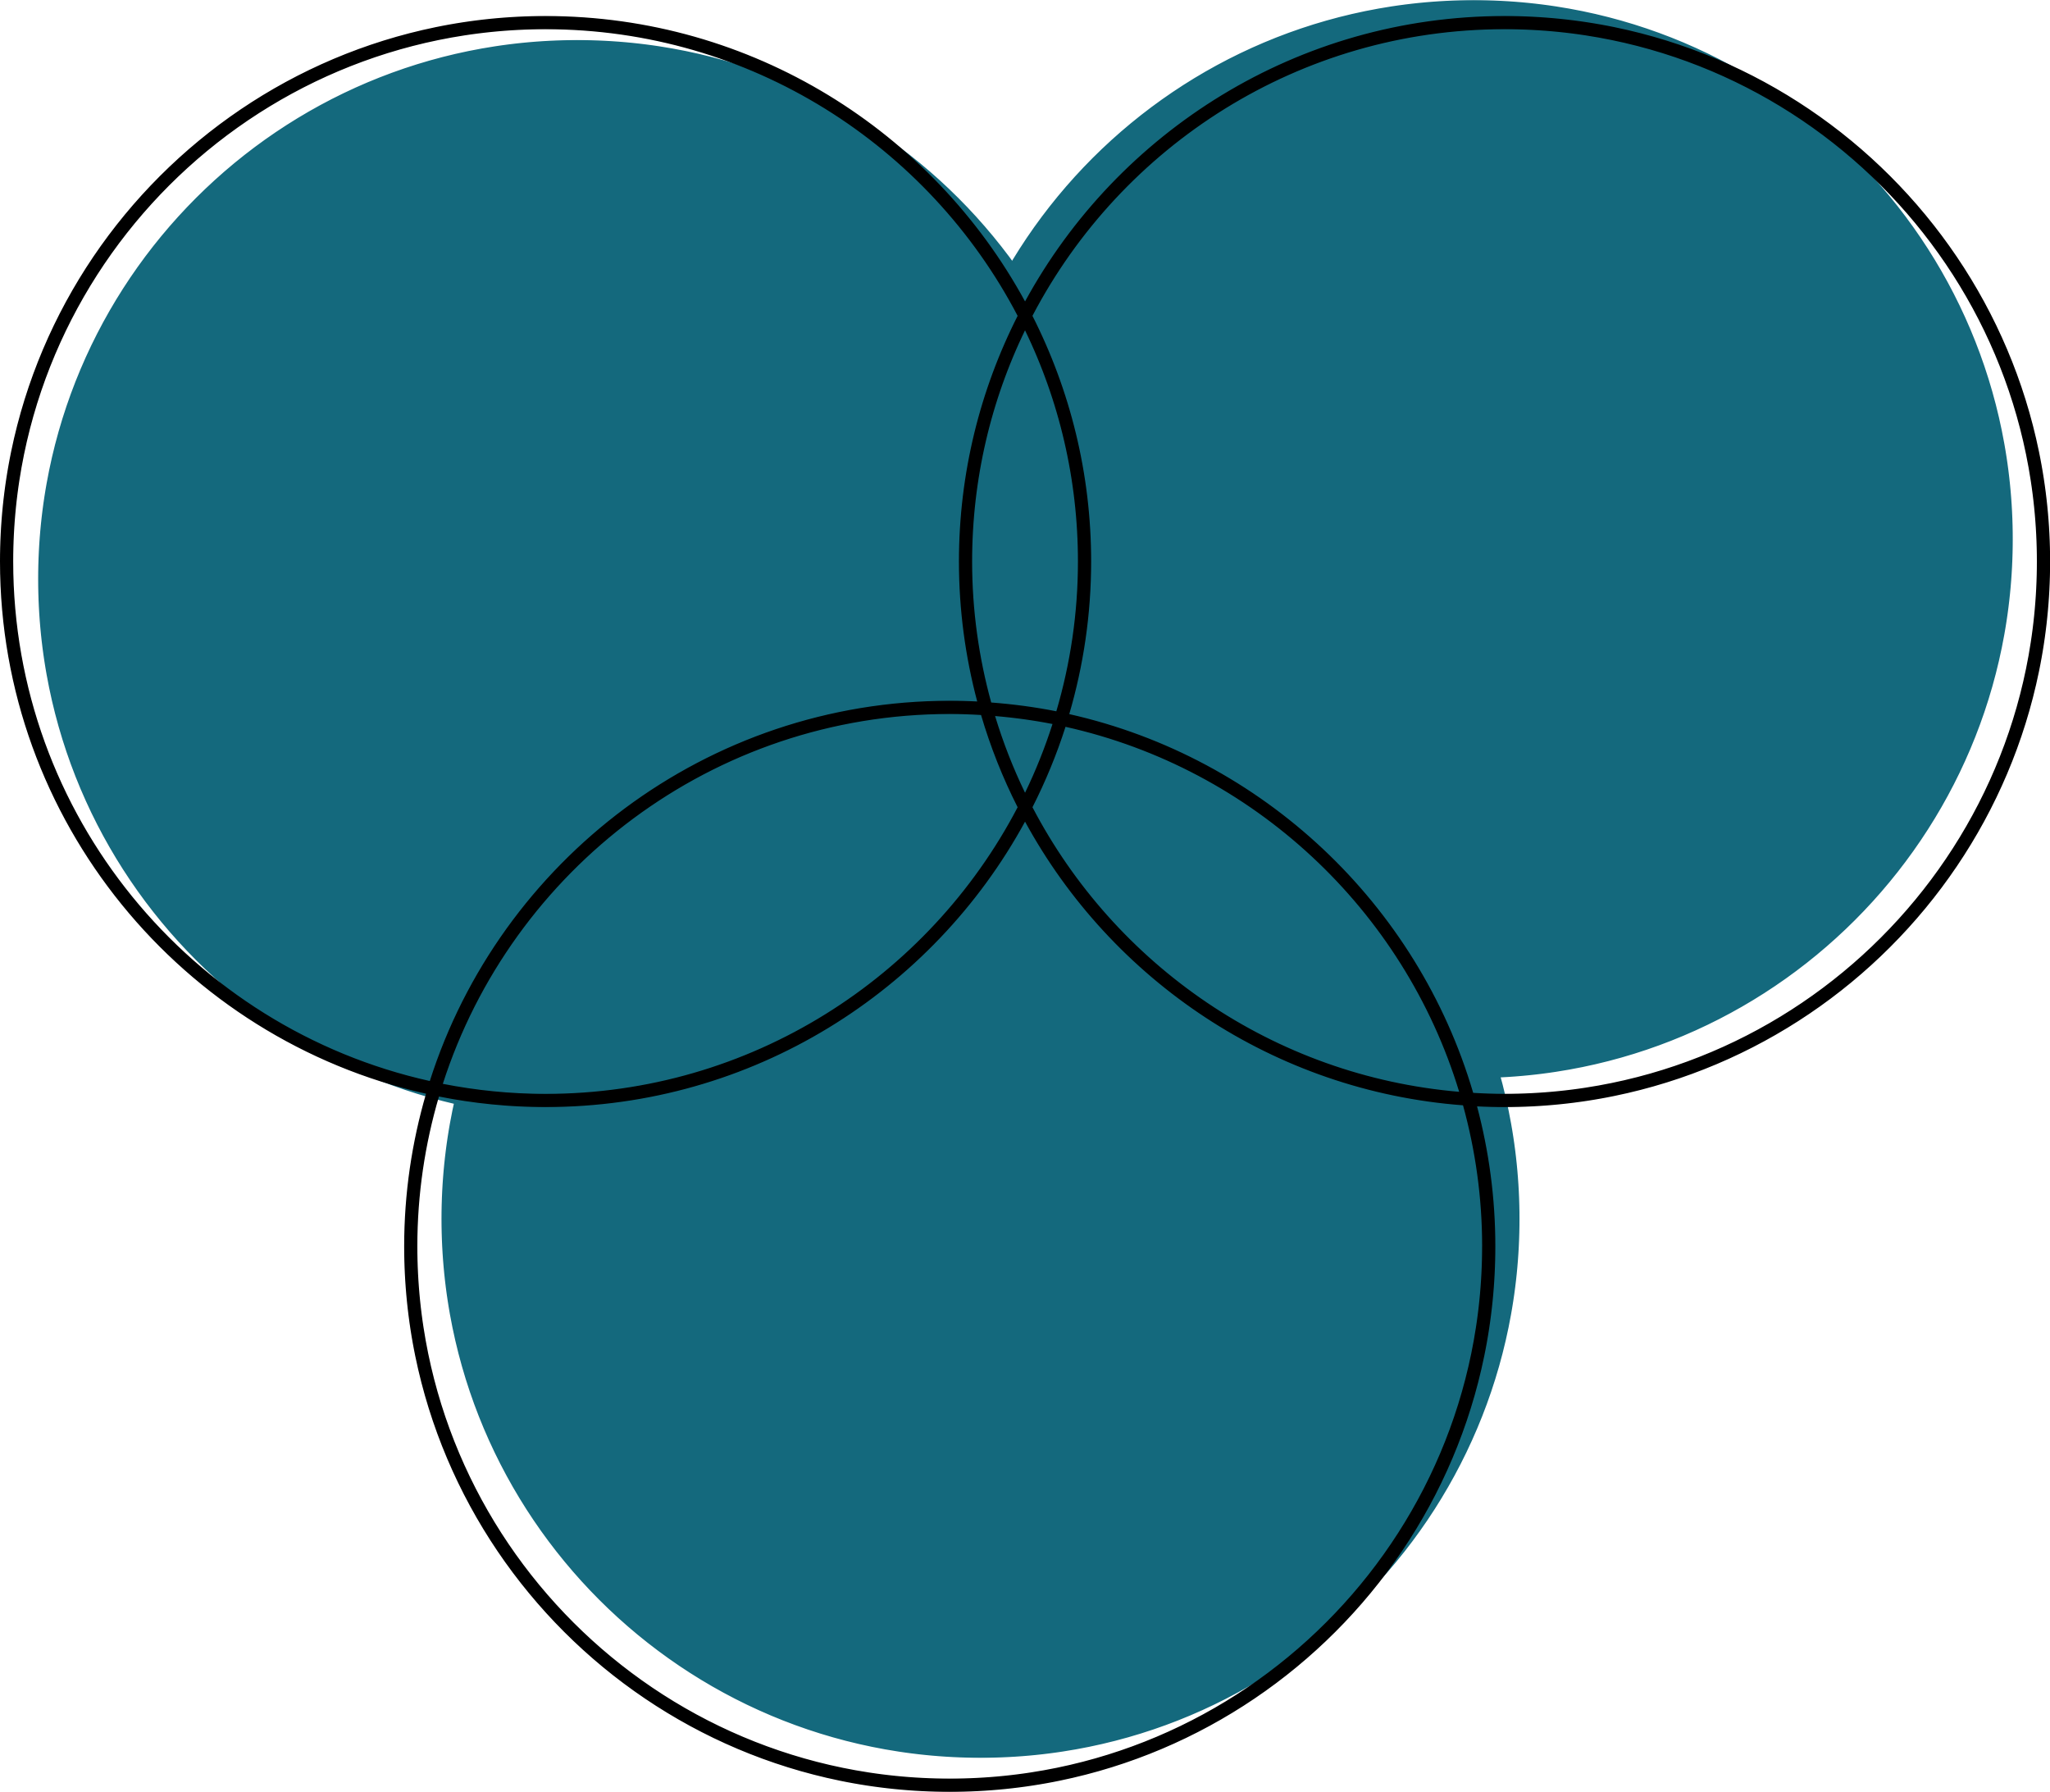

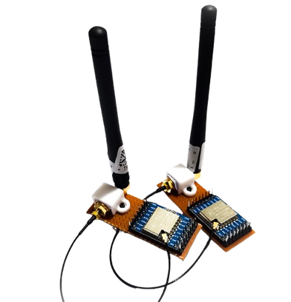
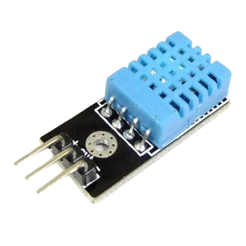

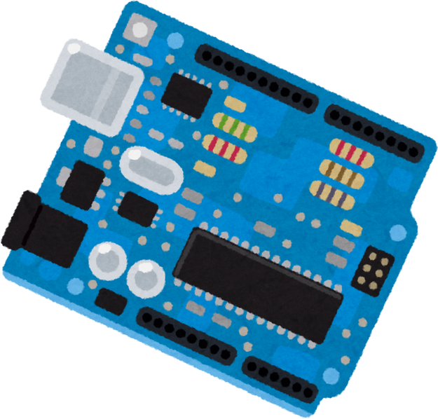
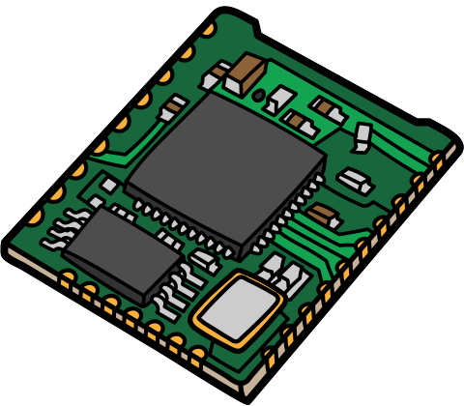



TEMPERATURE AND HUMIDITY DATA TRANSFER WITH LORA PROTOCOL
COMP 413 - INTERNET OF THINGS | INSTRUCTOR: DR. ABDULKADIR KÖSE
Transmitter Code
Receiver Code
Problem Statement
Transmitter Software
LoRa Module Communication
LCD Display
Receiving Data via LoRa Module:
Data Processing
Firebase Integration
Objective
This project aims to create a low-power system for monitoring and controlling temperature and humidity. Using LoRa for long-range data transmission, it collects sensor data, processes it on the server, and triggers actions like activating a fan. The system is scalable, customizable, and energy-efficient, making it ideal for long-term deployment and future improvements.
This project provides an efficient, low-power solution for monitoring and controlling temperature and humidity in remote areas. Traditional communication methods struggle with long-range, low-power needs, but using the LoRa protocol enables real-time data transfer over long distances.
Firebase and Wi-Fi
WiFi Connection
Firebase API Integration
LoRa Module
DFT Sensor
Temperature and
Humidity
Display
Server
Result and Discussion
The project successfully demonstrates the use of LoRa for low-power, long-range communication in environmental monitoring
To improve its real-world applicability, the system could benefit from enhanced range and robustness, further energy optimization, remote access capabilities, additional sensor integration, and scalability to monitor larger areas or multiple devices.
Group 19
İsmail Said Dönmez
Ömer Faruk Kılıçkaya
Emin Şahin

